Slide 1





Module 07 – subprocess
WWW.SELACLOUD.COM

Slide 2

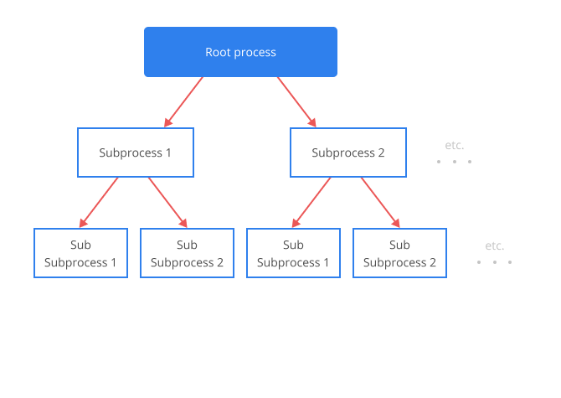
The subprocess module
The subprocess module provides a consistent interface to creating and working with additional processes.
The subprocess module has a wide functionality for running additional processes, controlling their lO, including shell feathers like wildcards, pipes, redirections
The subprocess module is an updated module for old and | [ deprecated functionality with the same purpose like: - os.system(), os.spawn*(), os.popen*() ...
Notes:
Python is dynamically-typed and garbage-collected. It supports multiple programming paradigms, including structured (particularly, procedural), object-oriented and functional programming.
It was built to be as readable as possible, and is significant indentation driven (Off-side rule).
The language's core philosophy is summarized in the document The Zen of Python (PEP 20), which includes aphorisms such as:
Beautiful is better than ugly.
Explicit is better than implicit.
Simple is better than complex.
Complex is better than complicated.
Readability counts.
For further reading:
Python (programming language) - Wikipedia

Slide 3
The call function
subprocess.call(args, stdin=None, stdout=None, stderr=None, shell=False, cwd=None, timeout=None)
Run the command described by args. Wait for command to complete, then return the returncode
Notes:
Python is dynamically-typed and garbage-collected. It supports multiple programming paradigms, including structured (particularly, procedural), object-oriented and functional programming.
It was built to be as readable as possible, and is significant indentation driven (Off-side rule).
The language's core philosophy is summarized in the document The Zen of Python (PEP 20), which includes aphorisms such as:
Beautiful is better than ugly.
Explicit is better than implicit.
Simple is better than complex.
Complex is better than complicated.
Readability counts.
For further reading:
Python (programming language) - Wikipedia

Slide 4
The call function example

Slide 5
The call function example
import subprocess subprocess.call("dir *.py", shell=True) # Remove the list and directly pass the command as a string subprocess.call([r"C:\Python27\test.py"]) # Remove shell=True subprocess.call("calc.exe", shell=True) # Remove the list and directly pass the command as a string with open(r"C:/Test/out.txt", "w") as f: # Use 'with' statement to automatically close the file subprocess.call('dir "/p"', shell=True, stdout=f) # Remove the extra quotation marks around /p print("end")

Slide 6
The check_output function
subprocess.check_output(args, stdin=None, stderr=None, shell =False, cwd=None, timeout=None)
Run command with arguments and return its output.
If the return code was non-zero it raises a CalledProcessError.

Slide 7
The check_output function example
import subprocess def get_command_output(cmd): try: output = subprocess.check_output(cmd, cwd="C:\someDir") # Use `cwd` instead of `cmd` return True, output except subprocess.CalledProcessError: return False, None isOk, output = get_command_output("dir")
Notes:
PyCharm is currently one of the most used IDE for python development, It provides code analysis, a graphical debugger, an integrated unit tester, integration with version control systems (VCSes), and supports web development with Django as well as data science with Anaconda.
It was created by JetBrains
It is mostly popular because of many things, such as:
It is considered as an intelligent code editor, fast and safe refactoring, and smart code.
Features for debugging, profiling, remote development, testing the code, auto code completion, quick fixing, error detection and tools of the database.
Support for Popular web technologies, web frameworks, scientific libraries and version control.

Slide 8
Lab 01

Slide 9
Popen class
The Popen class offers a lot of flexibility to handle the common and the less common cases not covered by the convenience functions.
To support a wide variety of use cases, the Popen accept a large number of optional arguments (in most cases, most of the arguments can stay with their default value)
Popen doen’t block the calling function
Notes:
PyCharm is currently one of the most used IDE for python development, It provides code analysis, a graphical debugger, an integrated unit tester, integration with version control systems (VCSes), and supports web development with Django as well as data science with Anaconda.
It was created by JetBrains
It is mostly popular because of many things, such as:
It is considered as an intelligent code editor, fast and safe refactoring, and smart code.
Features for debugging, profiling, remote development, testing the code, auto code completion, quick fixing, error detection and tools of the database.
Support for Popular web technologies, web frameworks, scientific libraries and version control.

Slide 10
Popen class — cont’d
The most common Popen constructor arguments (like in call and check_output functions) are:
— args
— shell
— stdin, stdout, stderr:
Existing file descriptor
PIPE - indicates that a new pipe to the child will be created
Notes:
PyCharm is currently one of the most used IDE for python development, It provides code analysis, a graphical debugger, an integrated unit tester, integration with version control systems (VCSes), and supports web development with Django as well as data science with Anaconda.
It was created by JetBrains
It is mostly popular because of many things, such as:
It is considered as an intelligent code editor, fast and safe refactoring, and smart code.
Features for debugging, profiling, remote development, testing the code, auto code completion, quick fixing, error detection and tools of the database.
Support for Popular web technologies, web frameworks, scientific libraries and version control.

Slide 11
Popen class

Slide 12
Popen example
import subprocess as SP r = SP.Popen(["dir"], shell=True) print(r.returncode) # probably None import subprocess as SP r = SP.Popen(["dir"], shell=True) print(r.returncode) # probably None import time time.sleep(3) print(r.returncode) # probably 0
Notes:
PyCharm is currently one of the most used IDE for python development, It provides code analysis, a graphical debugger, an integrated unit tester, integration with version control systems (VCSes), and supports web development with Django as well as data science with Anaconda.
It was created by JetBrains
It is mostly popular because of many things, such as:
It is considered as an intelligent code editor, fast and safe refactoring, and smart code.
Features for debugging, profiling, remote development, testing the code, auto code completion, quick fixing, error detection and tools of the database.
Support for Popular web technologies, web frameworks, scientific libraries and version control.

Slide 13
Popen with PIPE example
import subprocess as SP r = SP.Popen(["dir"], stdout=SP.PIPE, stderr=SP.PIPE, shell=True) output, error = r.communicate() # Use 'communicate()' instead of 'rcommunicate()' print(output.decode()) # Decode the output bytes and print print(error.decode()) # Decode the error bytes and print r = SP.Popen(["nodir"], stdout=SP.PIPE, stderr=SP.PIPE, shell=True) output, error = r.communicate() # Use 'communicate()' instead of 'rcommunicate()' print(output.decode()) # Decode the output bytes and print print(error.decode()) # Decode the error bytes and print
Notes:
PyCharm is currently one of the most used IDE for python development, It provides code analysis, a graphical debugger, an integrated unit tester, integration with version control systems (VCSes), and supports web development with Django as well as data science with Anaconda.
It was created by JetBrains
It is mostly popular because of many things, such as:
It is considered as an intelligent code editor, fast and safe refactoring, and smart code.
Features for debugging, profiling, remote development, testing the code, auto code completion, quick fixing, error detection and tools of the database.
Support for Popular web technologies, web frameworks, scientific libraries and version control.

Slide 14
Lab 02

